Slide 1
JEOPARDY

Slide 2
Cells
Cell
Function
Cell
Structure
Cell
Theory
Random
$100
$100
$100
$100
$100
$200
$200
$200
$200
$200
$300
$300
$300
$300
$300
$400
$400
$400
$400
$400
$500
$500
$500
$500
$500

Slide 3
$100
Cells with an organized nucleus

Slide 4
$100
What is an eukaryotic cell?

Slide 5
$200
Cells with DNA within the cytoplasm

Slide 6
$200
What is a prokaryotic cell?

Slide 7
$300
Genetic material is located in the nucleus of these types of cells

Slide 8
$300
What are eukaryotic cells?

Slide 9
$400
Cells such as plant and animal cells with an organized nucleus

Slide 10
$400
What is an eukaryotic cell?

Slide 11
$500
Bacteria is an example of this type of cell

Slide 12
$500
What is a prokaryote?

Slide 13
$100
Organelle that is the outermost part and provides a plant cell with rigidity

Slide 14
$100
What is the cell wall?

Slide 15
$200
Organelle that releases stored energy from sugars

Slide 16
$200
What is the mitochondria?

Slide 17
$300
Maintains homeostasis in the cell by storing water, food, and wastes

Slide 18
$300
What is a vacuole?

Slide 19
$400
Structure that regulates the movement of substances in and out of the cell

Slide 20
$400
What is the cell membrane?

Slide 21
$500
Structure that transports materials in a eukaryotic cell

Slide 22
$500
What is endoplasmic reticulum?

Slide 23
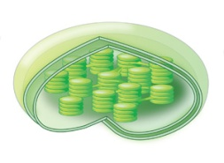
$100

Slide 24
$100
What is a chloroplast?

Slide 25
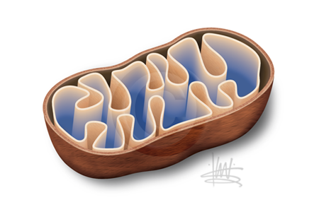
$200

Slide 26
$200
What is a mitochondrion?

Slide 27
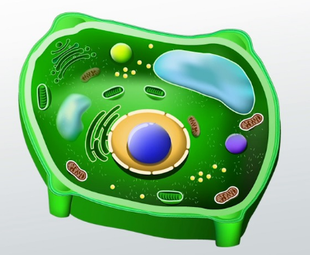
$300
Plant Cell

Slide 28
$300
What is the cell wall?

Slide 29
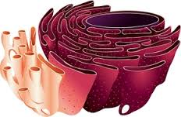
$400

Slide 30
$400
What is the endoplasmic reticulum?

Slide 31
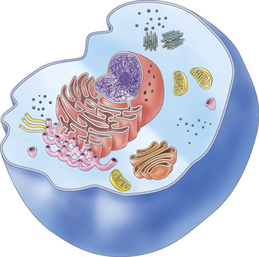
$500
Animal cell

Slide 32
$500
What is the cell membrane?

Slide 33
$100
Scientist that viewed a piece of cork and called the boxes he saw “cells”

Slide 34
$100
Who is Robert Hooke?

Slide 35
$200
Scientist(s) that designed the main part of the cell theory

Slide 36
$200
Who are Schleiden and Schwann?

Slide 37
$300
All living things are made of cells.
Cells are the basic units of living things.
Living cells come from living cells.

Slide 38
$300
What is the cell theory?

Slide 39
$400
German scientist that said “living cells come from living cells”

Slide 40
$400
Who is Rudolph Virchow?

Slide 41
$500
Designed the first compound microscope

Slide 42
$500
Who are Hans and Zacharias Janssen?

Slide 43
$100
The part of the cell that holds organelles

Slide 44
$100
What is the cytoplasm?

Slide 45
$200
The organelles that plant cells have that animal cells do not

Slide 46
$200
What are chloroplast and cell wall?

Slide 47
$300
Organelle that uses radiant energy to make sugar

Slide 48
$300
What is chloroplast?

Slide 49
$400
Organelle that releases stored energy from sugars

Slide 50
$400
What is mitochondria?

Slide 51
$500
Organelle that produces proteins

Slide 52
$500
What are ribosomes?

