Slide 1
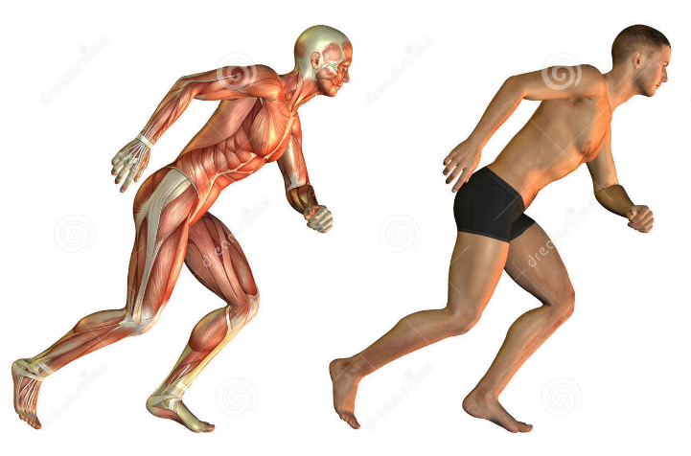
Muscular System

Slide 2
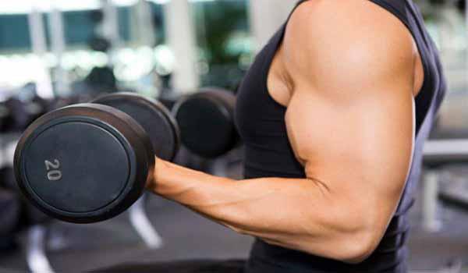
MUSCLES
Approximately 40% of your body weight
Approximately 650 muscles
Muscles only pull (they can’t push)
You have over 30 facial muscles
Eye muscles move more than 100,000 times a day

Slide 3
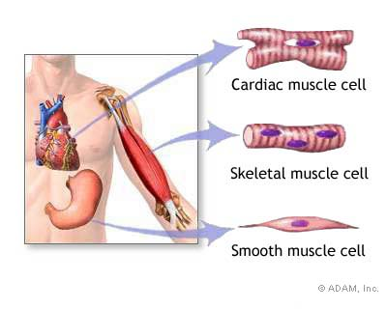
There are 3 types of muscle tissue
1. Skeletal
2. Cardiac
3. Smooth

Slide 5
Skeletal Muscle Functions
1. Skeletal muscle (that powers joints).
2. Smooth muscle (that moves internal organs, such as the bowels, and vessels, such as the artery walls)
3. Cardiac muscle (a type of muscle tissue that is found only in the heart)

Slide 6
Muscle Facts:
Muscles work in pairs.
Muscles can be voluntary or involuntary.
Skeletal muscles are voluntary.
Smooth and cardiac muscles are involuntary.
When flexors contract, extensors relax.

Slide 8
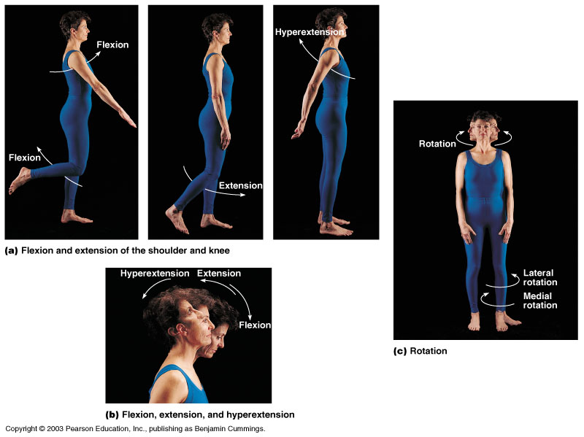
Slide 6.33
Body Movements
Figure 6.13
Copyright © 2003 Pearson Education, Inc. publishing as Benjamin Cummings

Slide 9
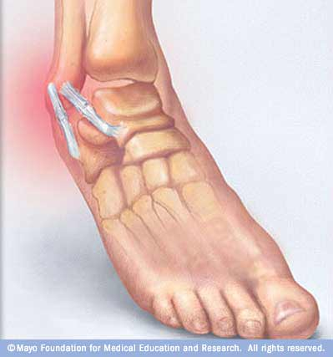
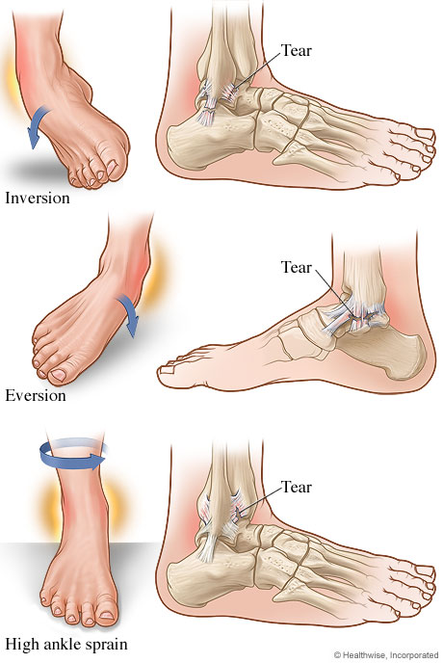
Ankle Sprains

Slide 10
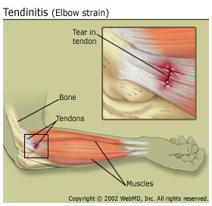
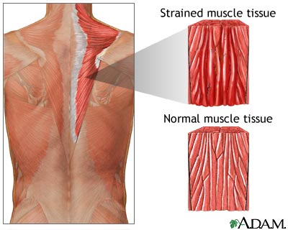
Examples of Strains

Slide 11
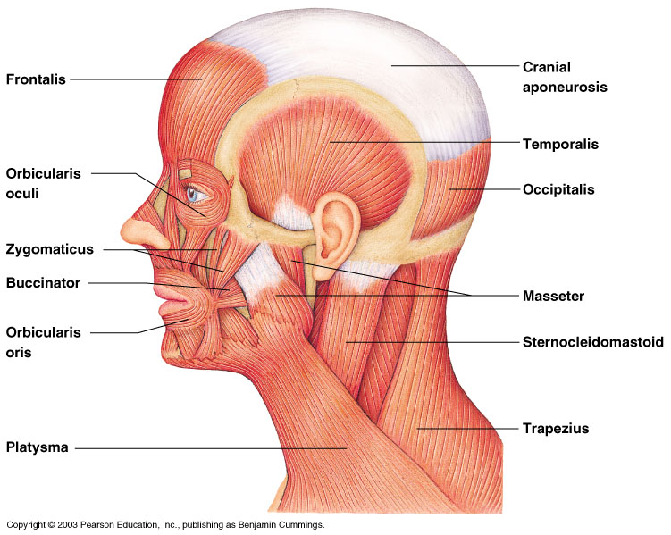
Slide 6.38
Head and Neck Muscles
Figure 6.14
Copyright © 2003 Pearson Education, Inc. publishing as Benjamin Cummings

Slide 12
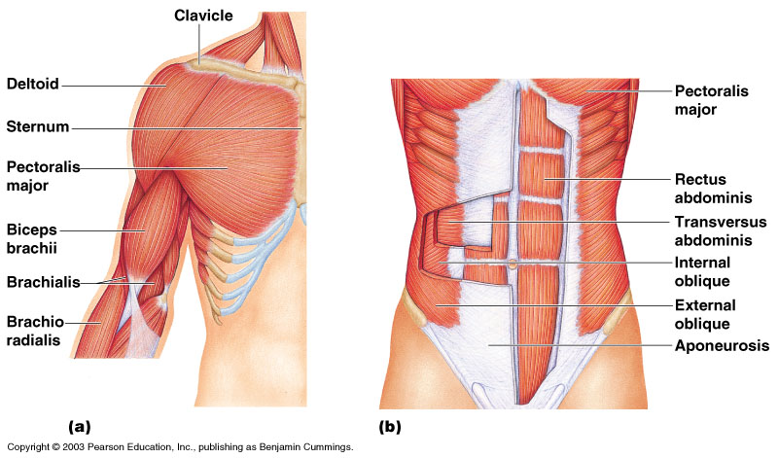
Slide 6.39
Trunk Muscles
Figure 6.15
Copyright © 2003 Pearson Education, Inc. publishing as Benjamin Cummings

Slide 13
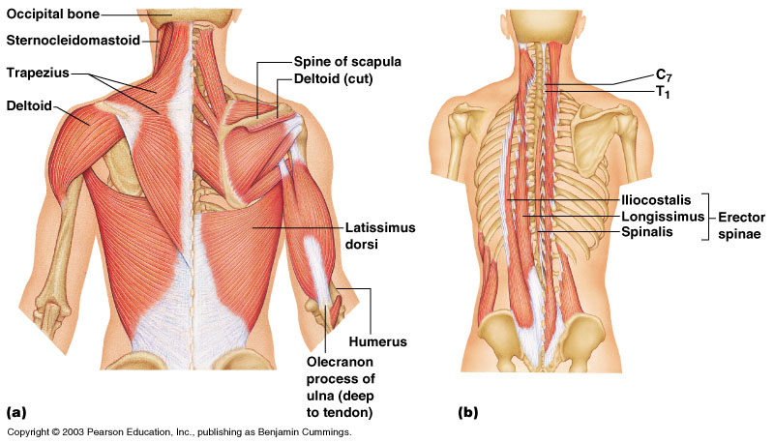
Slide 6.40
Deep Trunk and Arm Muscles
Figure 6.16
Copyright © 2003 Pearson Education, Inc. publishing as Benjamin Cummings

Slide 14
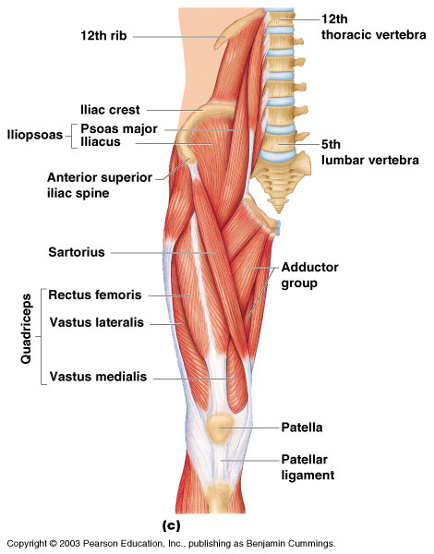
Slide 6.41
Muscles of the Pelvis, Hip, and Thigh
Figure 6.18c
Copyright © 2003 Pearson Education, Inc. publishing as Benjamin Cummings

Slide 15
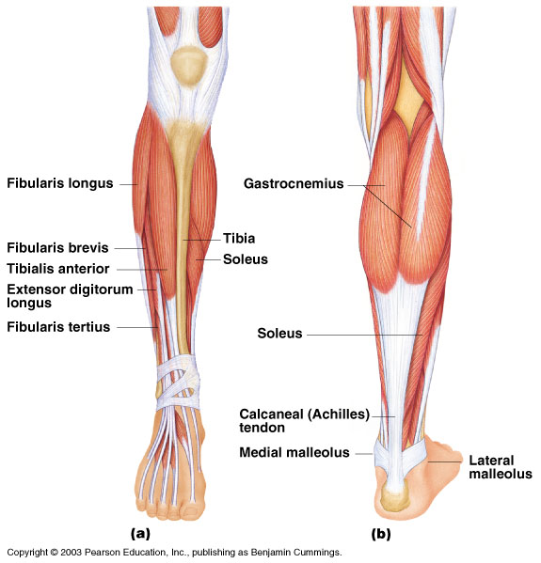
Slide 6.42
Muscles of the Lower Leg
Figure 6.19
Copyright © 2003 Pearson Education, Inc. publishing as Benjamin Cummings

Slide 16
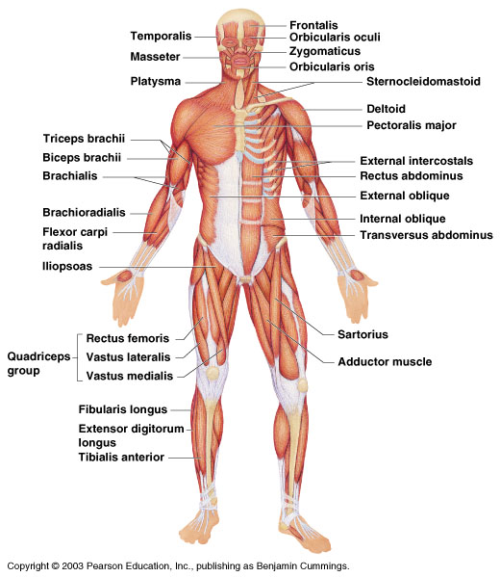
Slide 6.43
Superficial Muscles: Anterior
Figure 6.20
Copyright © 2003 Pearson Education, Inc. publishing as Benjamin Cummings

Slide 17
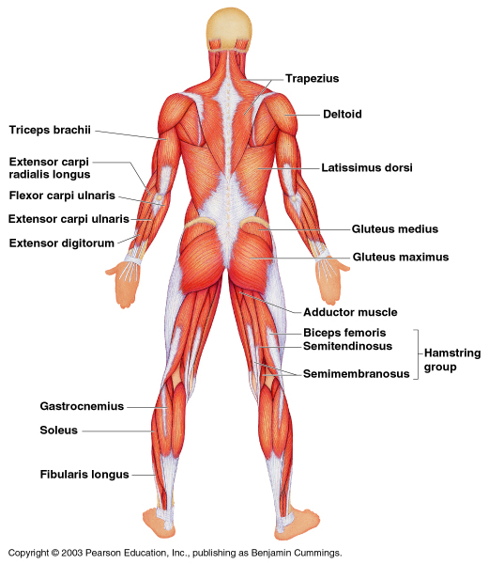
Slide 6.44
Superficial Muscles: Posterior
Figure 6.21
Copyright © 2003 Pearson Education, Inc. publishing as Benjamin Cummings

Slide 18
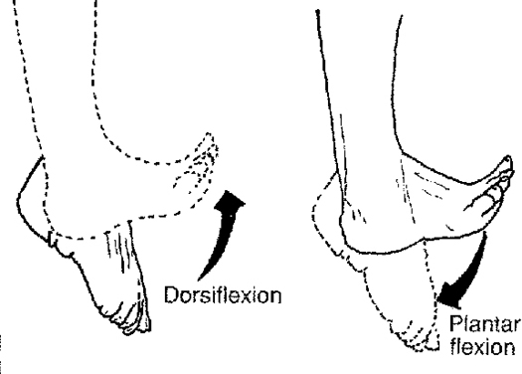
Special Movements
Dorsifelxion
Plantar flexion

Slide 19
Slide 6.34
Special Movements
Inversion
Eversion
Copyright © 2003 Pearson Education, Inc. publishing as Benjamin Cummings

Slide 20
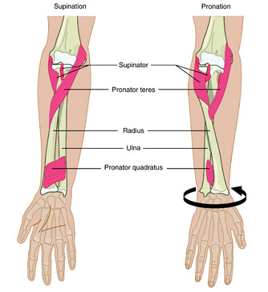
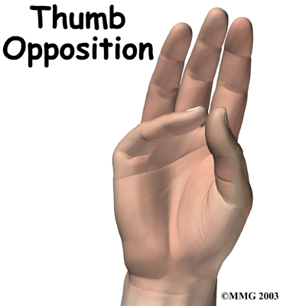
Special Movements
Opposition
Supination
Pronation

