Slide 1
SCIENCE FAIR
DEC. 2-4, 2015
PROJECTS DUE DEC. 1, 2015

Slide 2
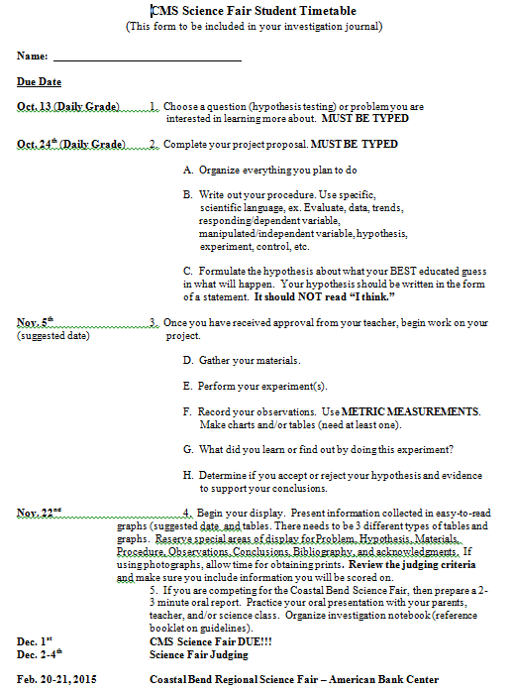

Slide 3
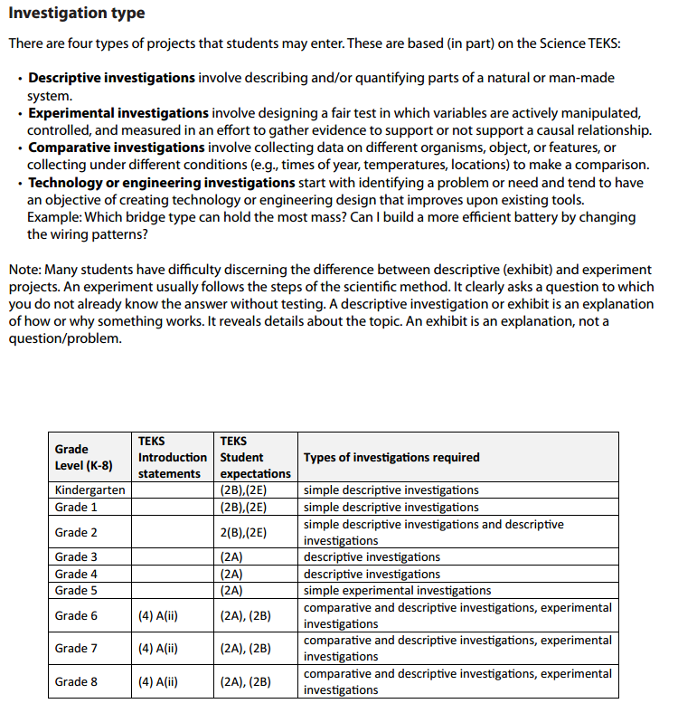

Slide 4
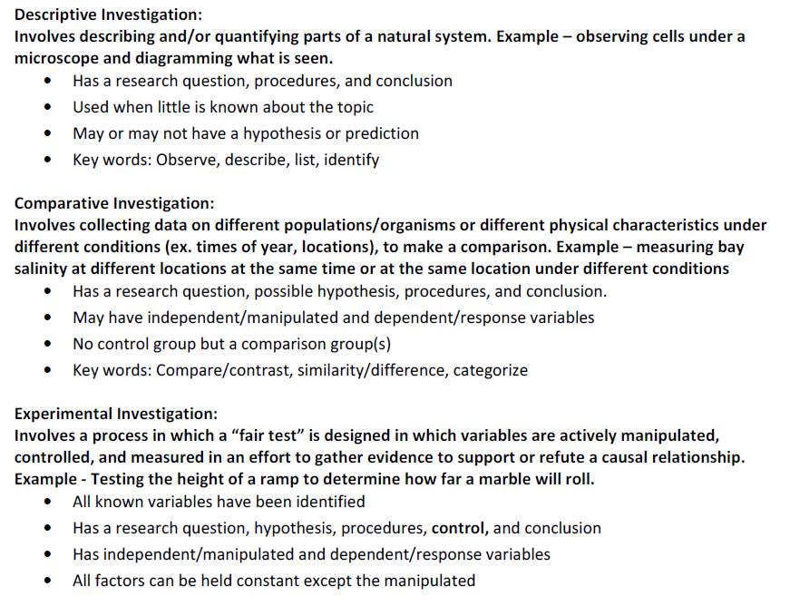

Slide 5
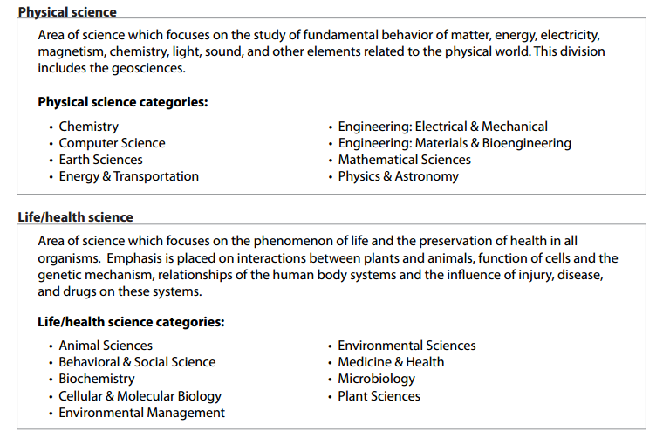

Slide 6
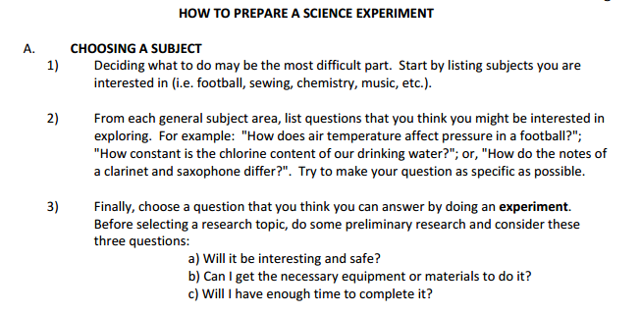
DUE DATE FOR TOPIC IS OCTOBER 13, 2014
FOR A DAILY GRADE

Slide 7
YOUR PROPOSAL which includes your written procedure
WILL BE DUE TO YOUR TEACHER FOR A DAILY GRADE
ON OCTOBER 24, 2014

Slide 9
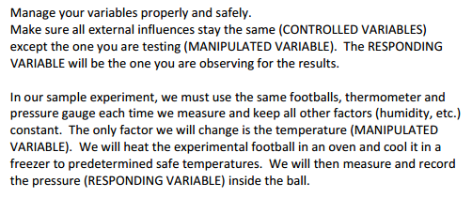
BEGIN ONCE YOU HAVE TEACHER APPROVAL!!!

Slide 11
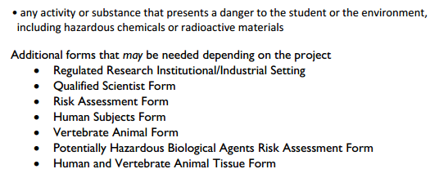
ALL FORMS CAN BE FOUND
ON THE WEBSITE
http://cbsf.tamucc.edu/

Slide 12
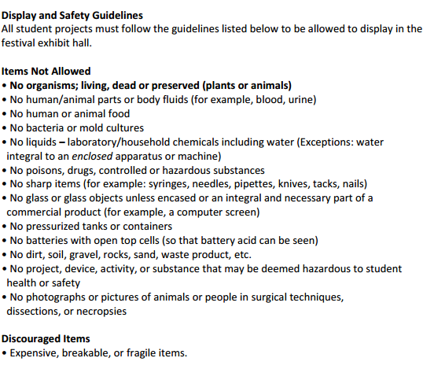

Slide 13
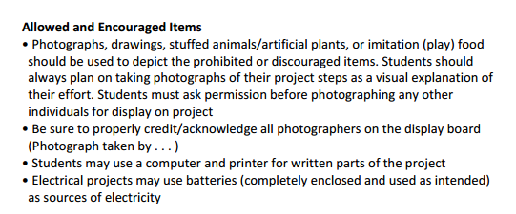

Slide 14
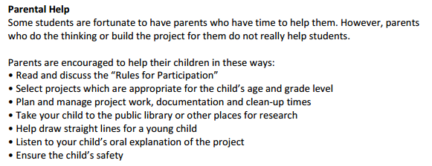

Slide 15
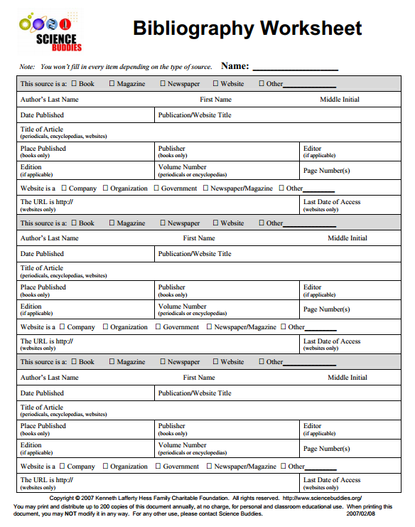
REQUIRED BIBLIOGRAPHY FORM TO USE ON DISPLAY BOARD
ALL FORMS CAN BE FOUND
ON THE WEBSITE
http://cbsf.tamucc.edu/

Slide 18
